Slide 1

PRESENTED BY
AKASH KARRETTI

Slide 2
Area 51 is a remote tract of land in the southwestern portion of southern Nevada in the western United States.
Situated at its center, on the southern shore of Groom Lake, a dry lakebed, is a large military airfield and one of the most secretive places in the world.
The base's primary purpose is to support development and testing of experimental aircraft and weapons systems.
Area 51 is also known by various names like Paradise Ranch, Watertown Strip, Dreamland, and Groom Lake

Slide 3
KNOWN FACTS
Since Area 51 is a secret military base, its true purpose is not completely known. Yet many hypothesis have been introduced and a few are almost definitely true.
Area 51 was originally designed to be a safe place for the president and the rest of the government to stay in during times of war or nuclear threat.
Area 51 was built to withstand a nuclear attack, since it is almost entirely underground.
It is also said that Area 51 is large enough to house the entire U.S. government, meaning it must be a huge underground facility.
It is believed that the place has almost all the tools the government has in Washington, meaning satellite control, radar, communications manipulation, and other features.
Widely accepted also is that Area 51 is a staging ground for the building and testing of ultra-modern aircraft and other technology.

Slide 4
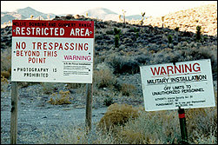
The Security Around Area 51
The security force patrolling the borderlands of the above top secret Groom Dry Lake has become known to the general public as the "Cammo-Dudes" .This is due to the multicolor desert camouflage uniforms that they wear.
Everything from surveillance cameras, magnetic trip sensors, and optical sensors can be found guarding the base.
If anyone try to trespass on the military base where Area 51 is located he will be shot dead.

Slide 5
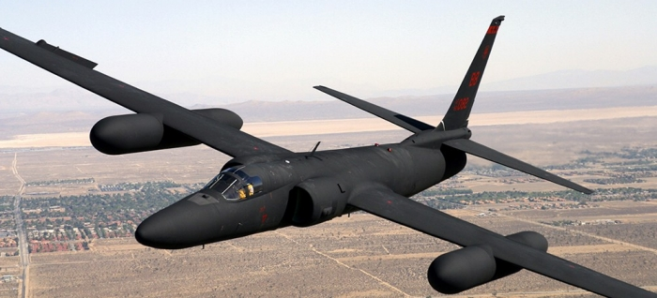
Conspiracies For Which It's Known For -
1. Lockheed U-2 (Dragon Lady)

Slide 6
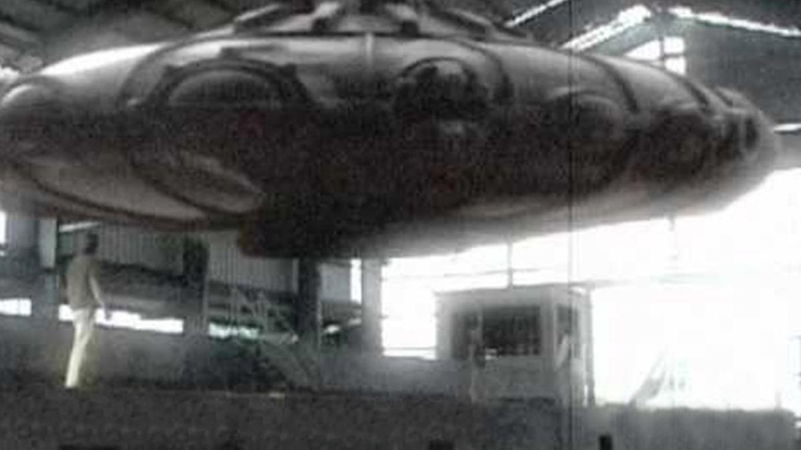
2. UFO In AREA 51 Region

Slide 7

3. Fake Moon Landing

Slide 8
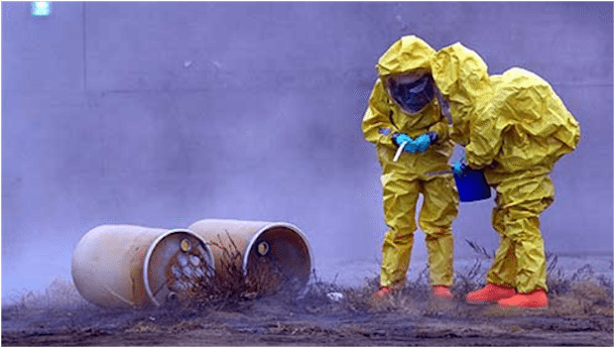
4 . The Real Cover Up

Slide 9
New Technologies Developed .
1. Project OXCART.
2. D-21 TagBoard .
3. Aurora Project
4.BLACK MANTA PROJECT

Slide 10
Thank you .

